Slide 1
https://powercybertestbed.ece.iastate.edu/
PUSH ALL WORK TO GITLAB AND IN VM!!!!!1!!!

Slide 2
Week 2

Slide 3
Who are Present Today
Justin, Kaya, Matt, Tommy, Zach

Slide 4
Overview of Work

Slide 5
Tyler - Work
Did a little more research with the Pandapower and DSS-Python documentation.
Was not able to meet with Thommy/Matt last week due to not feeling great Wednesday night and having other plans for the rest of the week/Easter weekend.
Future work: Get with Matt and Thommy Wednesday evening at our normal meeting time to get working on the attacks side of things.

Slide 6
Zach - Work
Wasn’t able to meet with team during our meeting last wednesday.
Finished Bi-Weekly Report
This past week I had a couple of projects due and wasn’t able to work on much, for the coming week I plan on catching back up with the team to help implement the attack and co simulation side of the project.

Slide 7
Justin - Work
Still stuck on the same issue as before
Tried to get the sender and receiver code that Kaya has been working on to work with the Dockers
Will help with future implementation with the work that Matt and Tommy are doing.
It begins to work with the broker and creates a connection, however the execution stage doesn’t get an error, but never starts. I want to test a few different things with Kaya’s code that will provide insight into what we need to do.

Slide 9
Kaya - Work
Link to IEEE bus paper mentioned last week: http://images.shoutwiki.com/mindworks/7/7e/IEEE_13_Bus_Power_System.pdf
Worked with Matt and Tommy on integrating pandapower and dsspython.
Dss-python does not have an API call regarding getting current. Can only get current from an element, or winding transformers.
Found how to create a standard type within pandapower, but need more information to implement.

Slide 10
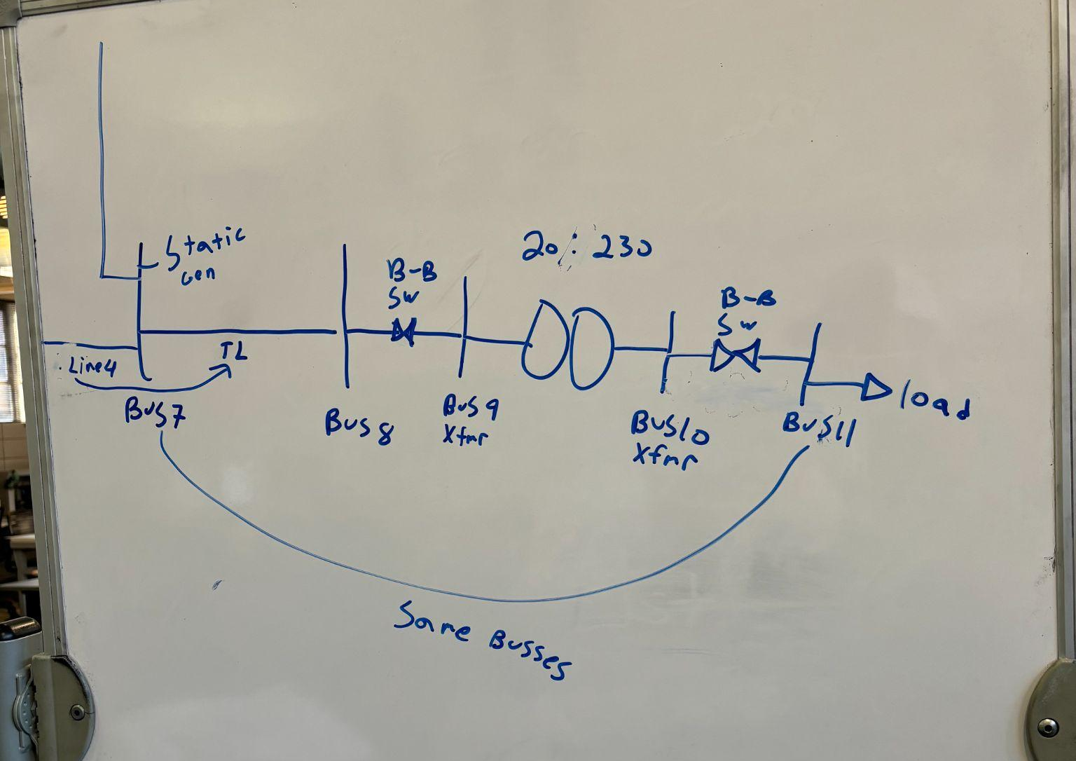
Tommy - Work
Met with Kaya and Matt to work further on implementation of helics with pandapower and dss
Panda Power
Using test case line but realized we needed additional transformer to change voltage for dss grid

Slide 11
Tommy - Work
Panda Power cont.
Does not appear that the pandapower has a pre made generator that matches the 230kV for santa fe power grid
https://pandapower.readthedocs.io/en/latest/std_types/basic.html#transformers
Santa fe source bus create statement:
What do you recommend for the interconnection point? Could you help us find a different point? Or help with the parameters to create a xfmr that meets the 230 kV.
Create xrmf: https://pandapower.readthedocs.io/en/latest/elements/trafo.html

Slide 12
Tommy - Work
DSS
As kaya mentioned before, we could not find a command to get current information at a bus
Tried looking for various other ways to get current information at separate equipment but could not find a reasonable solutions
Any recommendations for getting the current information to send to panda power?

Slide 13
Matt - Work
Met with Kaya and Tommy to work on co-simulation integration between pandapower and DSS-python
We decided that we will be adding an additional step-up transformer in pandapower in order to match the voltage level before sending the voltage to DSS-python
The generation voltage level is 20kV and we want to step it up to match the voltage level in the Sante Fe model
Worked with Kaya on creating our own standard transformer model that we can set the voltage levels for
There are a lot of parameters that we dont know for creating the standard model XFMR

Slide 14
Matt - Work
As mentioned by Kaya and Tommy, after looking for some time and trying several different commands from the DSS-python documentation we could not figure out how to extract the current
We can extract all of the currents, but they are shown in an unmarked matrix and it is nearly impossible to identify what current is pertaining to what part of the circuit

Slide 15
Next Week's Plan

Slide 16
Meeting Minutes

